Slide 1


Liquidity Risk Management 1.0, powered by SAP HANA
Applications Strategic Innovation InMemory Q1 2012

Slide 2


Liquidity Risk Management 1.0, powered by SAP HANA
Alternative Title Slide
Applications Strategic Innovation InMemory / December 2011
Oct 14th: The ECB will offer banks 12-month funds on Oct. 26 and again in December after already sparse interbank lending markets dried up again on worries over financial institutions' exposure to sovereign debt.
“
Sep 26th: The German industrial giant Siemens had withdrawn €500 million from one large French bank and placed it at the European Central Bank (ECB).
“
Oct 19th: Moody’s downgrades Spain’s credit rating, warns France on risks
“
Oct 13th: “We might end up in a situation similar to what happened in 2008 (…) and then of course there will be problems with liquidity.”
“
Confidential
* See last slide for sources

Slide 3

Legal Disclaimer
This presentation is not subject to your license agreement or any other agreement with SAP. SAP has no obligation to pursue any course of business outlined in this presentation or to develop or release any functionality mentioned in this presentation. This presentation and SAP's strategy and possible future developments are subject to change and may be changed by SAP at any time for any reason without notice. This document is provided without a warranty of any kind, either express or implied, including but not limited to, the implied warranties of merchantability, fitness for a particular purpose, or non-infringement. SAP assumes no responsibility for errors or omissions in this document, except if such damages were caused by SAP intentionally or grossly negligent.

Slide 4
Liquidity Risk Management 1.0, powered by SAP HANA
What is HANA?
Challenges in Liquidity Risk Management
LRM@HANA Overview
Detailed Scope of LRM@HANA 1.0

Slide 5




In-Memory Computing – The Time is NOW
The elements of In-Memory computing are not new. However, dramatically improved hardware economics and technology innovations in software has now made it possible for SAP to deliver on its vision of the Real-Time Enterprise with In-Memory business applications
HW Technology Innovations
SAP SW Technology Innovations
Multi-Core Architecture (8 x 8core CPU in one server)
Massive parallel scaling with many blades
One blade ~$50.000 = 1 Enterprise Class Server
Row and Column Store
Compression
Partitioning
64bit address space max at 2TB in current servers
100GB/s data throughput
Dramatic decline in price/performance
No Aggregate Tables

Slide 6











SAP HANA™ Is THE solution to the following:
SAP
HANA
?
?
?
Data Volume
Calculation Speed
Information Latency
Next Gen Platform for SAP Apps = OLAP+OLTP
Notes:
6

Slide 7
Usage scenarios of SAP HANA for Banks
Technology
Accelerators
BW on HANA database
Reporting
High Performance applications
SAP HANA
AFI@HANA Step 1
Transaction History
Financial Reporting
EDW for SAP and NON-SAP data
In-memory computing
AFI@HANA Step 2
Liquidity Risk Management
Analytics on any data source

Slide 8
Liquidity Risk Management 1.0, powered by SAP HANA
What is HANA?
Challenges in Liquidity Risk Management
LRM@HANA Overview
Detailed Scope of LRM@HANA 1.0

Slide 9
Challenges in Liquidity Risk Management
BASEL III REQUIREMENTS
Compliance to New Liquidity Rules under Basel III is a must
Moving Target as full Basel III Implementation runs to 2018
Reduzierung des Zeithorizontes
Ut enim ad minim veniam, quis nostrud exercitation
MARKET
BASEL III
MARKET SITUATION
Mortgage crisis, European debt crisis, what´s next?
Increasing costs for refinancing and liquidity procurement
LIQUIDITY RISK MANAGE-MENT
ORGANIZATION & PROCESSES
LRM ENVIRONMENT
Strong collaboration between different LoBs required
Change in liquidity management processes possible
DATA VOLUMES
ORGANI- ZATION& PROCESSES
HIGH DATA VOLUMES
Cash flow orientation causes huge data volumes
How to handle these volumes for adhoc steering purposes?
Aktualität der Planungsgrundlage mit entsprechend konkreten Zielvorgaben
ANALYTICS
ANALYTICS
Simulations, predictive analytics, scenario analysis required
A solution needs to cover compliance, analytics and steering
Multidimensional challenges impact the whole banking and liquidity arena

Slide 10
Liquidity Risk Management Process Overview
Risk Identification
Risk Analysis & Assessment
Identify and collect risks
Identify risk drivers
Assess risk probability and risk effects
Analyze quantitave and qualitative risk drivers
1
2
LIQUIDITY RISK MANAGE-MENT
Management reporting, regulatory reporting etc.
Measures & instruments to influence risk position
4
3
Monitor risk position and risk measurements
Steer liquidity
Risk Reporting & Monitoring
Risk Treatment

Slide 11
SAP LRM@HANA – a new level of risk management
Risk Identification
Real-time identification of risks
Know your risks faster and better with SAP LRM@HANA
Risk Analysis and Assessment
Deep dive into intraday risk position
Real-time compliance monitoring
LIQUIDITY RISK MANAGEMENT with SAP LRM@HANA
Risk Reporting & Monitoring
Flexible consumption: real-time reporting anytime and anywhere
Risk Treatment
Intraday risk measurement enables real-time, data-driven liquidity procurement
Support reporting needs from business analyst to CRO

Slide 12
Funding Liquidity Risk (Internal Risk Management)
Funding Liquidity Risk is the risk that the firm will not be able to efficiently meet both expected and unexpected current and future cash flow and collateral needs without affecting either daily operations or the financial condition of the firm (Basel Committee on Banking Supervision*).
A first step of a funding liquidity risk calculation consists in calculating the Forward Liquidity Exposure (FLE) in terms of the Legal Cash Flow Gap.
As this Forward Liquidity Exposure only shows contractual cash flows, the figure is an important indicator but somehow misleading in terms of shown liquidity bottlenecks. Therefore, in a second step hypothetical cash flows should be taken into account to show a more realistic picture. These simulations should be driven by market development, customer behavior and bank strategy to generate a more realistic Economic Cash Flow Gap.
Liquidity gaps detected when analyzing the economic cash flow gap can be netted against the Counterbalancing Capacity (CBC). It contains assets like bonds or committed lines that can be used to resolve liquidity bottlenecks.
*: BCBS 144 Principles for Sound Liquidity Risk Management and Supervision

Slide 13
Market Liquidity Risk (Internal Risk Management)
Market Liquidity Risk is the risk that a firm cannot easily offset or eliminate a position at the market price because of inadequate market depth or market disruption (Basel Committee on Banking Supervision*).
This risk could come up in conjunction with OTC trades or when solving liquidity gaps with the release of huge positions exceeding usual trading volumes.
*: BCBS 144 Principles for Sound Liquidity Risk Management and Supervision

Slide 14
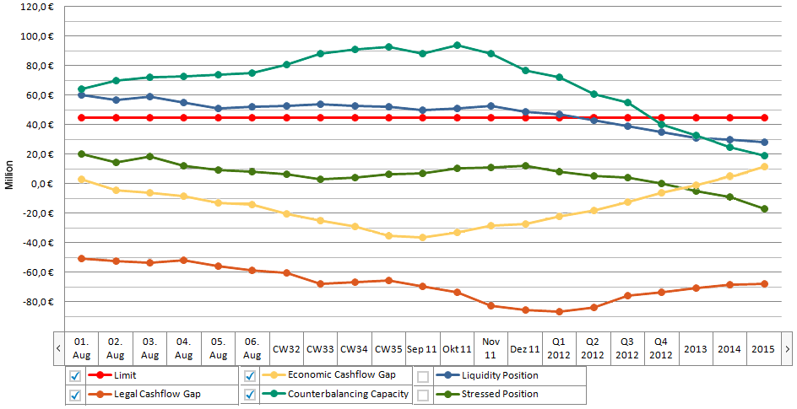
Funding Liquidity Risk closely linked to other risk types
Credit Risk
Market Risk
Operational Risk
Funding
Liquidity Risk
Market
Liquidity Risk
General
Market Risk
Specific
Market Risk
Cash Flows
Market depth
Volatility within general market: equities, currencies, curves, …
Volatility of specific market against general market
Residual
Risk
Event
Risk
Incremental
Default Risk
e.g. spread risk interest rate curve against rating curve
e.g. crashes, mergers, rating changes
e.g. default within structured credit

Slide 15
Asset Liability/ Treasury view on Funding Liquidity Risk
Assets:
Cash
Loans
Derivatives
Securities
...
Liabilities
Deposits
Issues
Derivatives
Other
...
Funding
Gap Profile
Funding
Collateral
Collateral
Funding
Collateral
Money Market
Instrument, funding and collateral cash flows to be integrated into overall analysis.

Slide 16
Liquidity Risk Management 1.0, powered by SAP HANA
What is HANA?
Challenges in Liquidity Risk Management
LRM@HANA Overview
Detailed Scope of LRM@HANA 1.0

Slide 17
Product Vision and Release Plan SAP LRM 1.0
Vision
Liquidity Risk Management, powered by SAP HANA, enables banks to perform real time, high-speed liquidity reporting and risk management on large volumes of individual cash flows and granular assets and liabilities.
The application allows for pooling all types of cash flows, including operative, simulated, and stressed data from various SAP and non-SAP source systems.
It delivers a framework to calculate risk management key figures and provides out-of-the box calculation for a representative set of regulatory key figures such as the Basel III ratios.
Users can apply basic stress factors to the data, for example to gauge the effect of varying haircut and run-off rates, or the re-classification of certain assets.
Simple and intuitive UIs enable business users to analyze and compare scenarios.
Release Date
SAP LRM Release 1.0 is planned to be released in June 2012.
we are looking for customers to validate release 1.0 in April and May 2012 (details see slide 21)

Slide 18

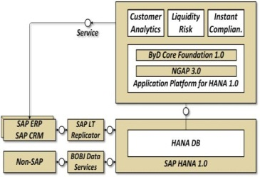
What is a High Performance Application (HPA)?
A HPA from a Business Perspective…
…provides value to customers by allowing to analyze extremely large data volumes with unprecedented performance
…closes the insight-to-action loop for the addressed business scenario.
…targets mainly existing large enterprise customers via a non-disruptive side-by-side implementation and with extremely short time-to-value.
…will be available starting Q2/2012
A HPA from a Technical Perspective…
….combines data from multiple source systems, including non-SAP systems.
…contains major analytical parts complemented with transactional processes.
…leverages HANA to deal with huge volumes of detailed granular replicated and local data, with built-in predictive calculations in real-time.
…leverages NGAP + ByDesign Core Foundation to include collaborative and transactional capabilities and trigger actions locally and in connected systems.

Slide 19
High Performance Applications – Generic Architecture
High
Performance
Applications
New applications powered by SAP in-memory computing:
New applications that take advantage of the new application ABAP programming language.
New releases of SAP products leverage in-memory technology
Examples:
High Performance Customer Analytics
High Performance Product cost calculation
High Performance Liquidity Risk Management for banks
SAP Business
Suite
SAP HANA
Foundation
Application Layer
Lean Analytics
NGAP
Traditional DB
Replication

Slide 20

Liquidity Risk Management@HANA Architecture
BI
NGAP
SAP Liquidity Risk App
SAP HANA
In-Memory
ETL
Upload stressed & unstressed Cash Flows for current and simulated business
Cash Flow Pool (non-SAP)
SAP Bank Analyzer
SAP LRM is open to import cashflow data from various source systems and/or a cashflow pool such as the SAP Bank Analyzer.
Cash Flow Engine
SAP Cash Flow Engine/
Strategy Analyzer
Operational Systems (SAP and non-SAP)
Loans
Deposits
Securities
Derivatives

Slide 21
LRM System Landscape

Slide 22
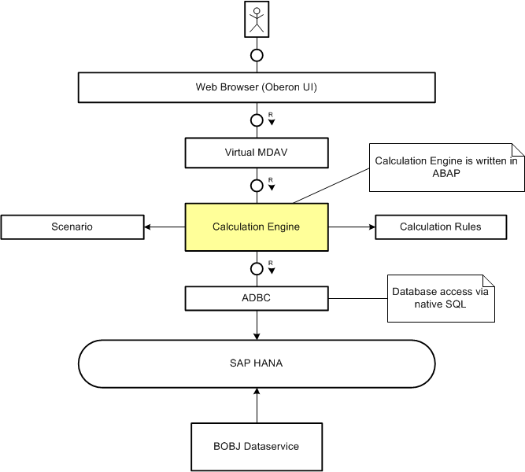
LRM Architecture

Slide 23
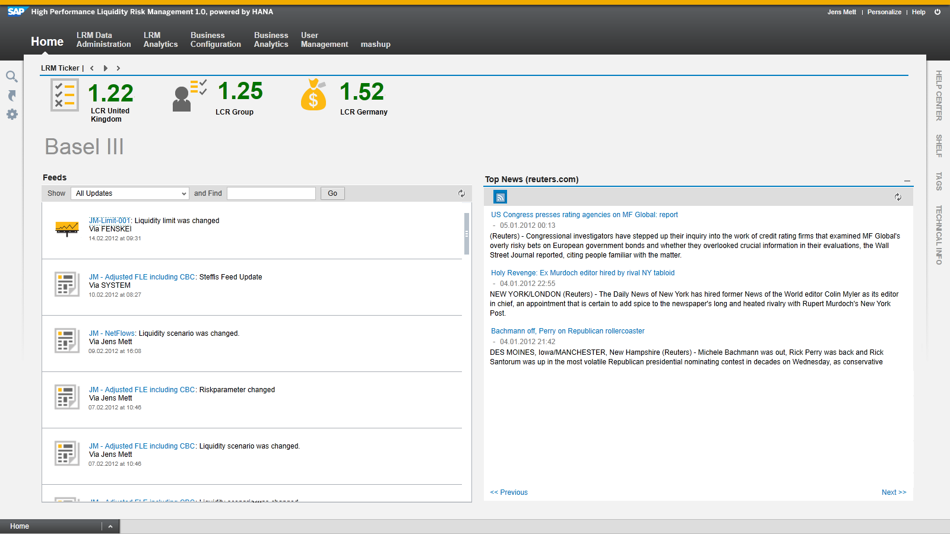
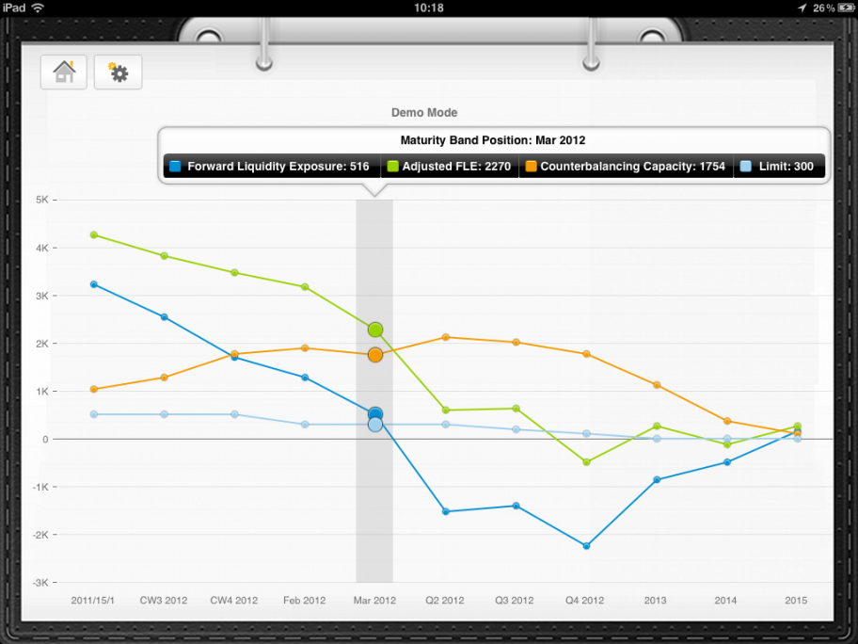
User Experience & Collaboration
The home screen is the user’s starting point into the LRM application
The LRM ticker monitors evolution of important KPIs and their limits
Feeds inform about other users’ activities
News provide information from the outside world
Mobile LRM enables
Access to LRM reports everywhere and at any time
collaboration with mobile LRM users

Slide 24
Models of Cooperation Collaboration to shape the next products and solutions
Innovation
Objective
PLANNED SOLUTION
Shape next innovations of SAP’s products and solutions
Collaboration to ensure market viability of new products and solutions
Give customers early insight in innovation areas and focus
Next products and solutions
SAP
Customer Community
Define set of engagement areas
Drive engagement process
Develop software
Deliver software in enhancement packages, new versions, or new software products
Influence the requirement specifications
Become instrumental for development and test
Engage in Customer Proof
Source: QGP, TIP, GCC, GC

Slide 25

Potential Activities for Customer Involvement
Review of requirements documents
Review of process models
Input regarding business and IT requirements
Prioritization of requirements
Testing
Support to create a realistic test environment
Review of user interface mock ups
Feedback on demos
Monthly update on development cycles
Validation of developments after development close
Coming up in Q2/2012

Slide 26
Success Factors for the Customer Validation
The data used for testing (mostly cash flows) has to be modelled to represent a realistic customer portfolio with respect to the products and the time evolution. Reviews and validation of the test portfolio by the customer are necessary. Ideally real customer data could be used but generated data is sufficient to avoid the costly import process from an operative source system.
A realistic data volume is needed to validate the high performance capabilities of the solution (starting at approximately 100 GB) and should be adapted to the concrete customer situation.
The scope is based on the full test catalog an needs to be prioritized with the customer to cover the most relevant aspects to be tested by the customer.
Qualified testers with the necessary business knowledge need to be nominated by the customers to assure an effective validation. These could be employees as well as trusted consultants working with the customer.
In order to assure an efficient test and intensive collaboration with development at least a 1 - 2 weeks test period in Walldorf is recommended. Details have to be adjusted according to customer availability.
Participating customers must be willing to serve as a reference. They have to agree to SAP using the successful test result as a proof point for the scope and quality of the solution, which has met the customers expectations.
High Data Quality
Realistic Data Volume
Meaningful Scope
Qualified Testers
Location&Timeline
Committment
&Testimonial

Slide 27
2 Options for Co-Innovation Participation Design Partner versus Validation Partner
Category | Criteria | Design Partners (1-2 customers) | Validation Partners (2-5 customers)
Co-Innovation Benefits | Direct Influence on SAP's Next Generation Products | High | Limited
 | Early Access to SAP's Latest Software | X
SAP Offering | Executive Sponsor | X
 | Dedicated Co-Innovation Single Point of Contact | X
 | Monthly Updates About Latest Developments | X | X
 | Monthly Live and Recorded Demos of All Development Milestones and UI Mockups | X
 | Live and Recorded Demos of Selected Major Development Milestones | X | X
 | Onsite Product Design Workshops | X
 | Close Collaboration with the Development Teams | X
Customer Investment | Onsite Roll in Workshops with SAP with both Business Users and IT | X
 | Review Market Requirement Documents | X | X
 | Review Mockups | X | X
 | Review of Live and Recorded Demos | X | X
 | Participation in Surveys to Rank or Validate Proposals | X
 | Participation in Usability Studies | X
 | Participation in Tests (@SAP Offices) (quarterly) | X
 | Provisioning of Real / Realistic Data for Test and Development Purposes | X
Prerequisites for Participation | Executive Sponsor | X
 | Commitment to Participate until End of 2012 | X | X
 | Customer Project Lead as Single Point of Contact | X
 | NDA & Feedback Agreement Signed | X | X
 | SAP Development Team Being Able to Talk to End Users | X

Slide 28
Liquidity Risk Management 1.0, powered by SAP HANA
What is HANA?
Challenges in Liquidity Risk Management
LRM@HANA Overview
Detailed Scope of LRM@HANA 1.0

Slide 29
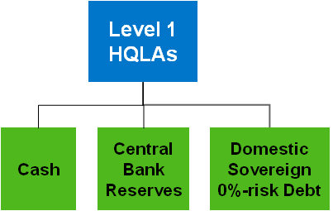

Liquidity risk processing with LRM@HANA Rel. 1.0
Coverage
Process Step
Reporting & Analysis
Detailed Analysis
What-If Analysis
Legal Reporting
Cash flow aggregation
Aggregation
Cash flow generation
Transaction

Slide 30
LRM Data Model
Instead of a normalized data model
We used an almost denormalized data model

Slide 31
The Cashflow Object
‘Logical’ Key Fields
Header
Source System
Contract
View
Scenario
Time-stamp
Node Type
Product Data
Customer Data
Org Data
Collate-ralization
Structured Product Data
Basel III Categorization
Other…
Items
Date
Amount
Currency
Item Category
Other…
The Cashflow Object is the core transactional data object in LRM@HANA
It has a very flat, denormalized header-item structure
to take maximum advantage of HANA’s columns store
as a consequence, the same contract (or transaction or deal) can have several versions, views and scenarios
…and all combinations lead to a new cashflow object
Most fields need not necessarily be filled.
There are some ‘must’ fields defined by SAP, e.g. the logical key, or the date, amount, currency on item level.
Customers can define ‘must’ fields per product type.

Slide 32
The Cashflow Object for Structured Products
To keep the performance advantages of the flat, de-normalized data structure, LRM has no hierarchical data model for structured products.
The legs / nodes of a structured products are cashflows with
the same Contract ID
a field containing the type of the structured product (e.g. repo, interest swap)
a key field “node type” denoting the purpose of the leg / node (*)
conceptual, normalized product structure
‘flat’, de-normalized LRM data model
Header
4711
Repo
Leg
Cash
Forward Security Transaction
4711
Cash
Repo
4711
Forward Security Transaction
Repo
Item
Items
Items
Items
Items
(*) multiple legs with the same role can be identified uniquely by numbering the node types, e.g. 'cash1', 'cash2' etc.

Slide 33
The Cashflow Object – View and Scenario
The VIEW describes how the contract was rolled out into a cashflow
The SCENARIO describes which set of parameters were used to model the non-deterministic components
Examples:
Product Scenario View
Bond Baseline Legal Liquidation
Stressed Legal Liquidation
Loan Baseline Legal Economic
Stressed Legal Economic

Slide 34
The Cashflow Object – Versioning in ‘Insertion Mode’
1
Version | From-Date | To-Date
1 | 01.01.2011 | 31.12.9999
Original Version
01.01.2011
BusRecTime
Version | From-Date | To-Date
1 | 01.01.2011 | 01.02.2011
2 | 01.02.2011 | 31.12.9999
This version is delimited
2
A new version arrives and delimits the original version
01.01.2011
01.02.2011
BusRecTime
A third version with a from-date before the latest versions from-date arrives and is inserted into the sequence of versions.
Version | From-Date | To-Date
1 | 01.01.2011 | 15.01.2011
3 | 15.01.2011 | 01.02.2011
2 | 01.02.2011 | 31.12.9999
3
This version is inserted
01.01.2011
15.01.2011
01.02.2011
BusRecTime

Slide 35
The Cashflow Object – Versioning in ‘Overrule Mode’
1
Version | From-Date | To-Date
1 | 01.01.2011 | 31.12.9999
Original Version
01.01.2011
BusRecTime
Version | From-Date | To-Date
1 | 01.01.2011 | 01.02.2011
2 | 01.02.2011 | 31.12.9999
2
A new version arrives and delimits the original version
01.01.2011
01.02.2011
BusRecTime
A third version with a from-date before the latest versions from-date arrives and overrules the sequence of versions by deactivating or delimiting prior versions.
Version | From-Date | To-Date
1 | 01.01.2011 | 15.01.2011
2 | 01.02.2011 | 01.02.2011
3 | 15.02.2011 | 31.12.9999
This version is delimited
3
This version is deactivated
01.01.2011
15.01.2011
01.02.2011
BusRecTime

Slide 36
Management of Big Data in LRM: Volume Drivers
 | Example Bank
Volume Drivers | Low Estimate | High Estimate
# of contracts and deals reflects potential aggregation & compression in source systems | 5M | 20M
# of items per contract | 25 | 100
Daily refresh rate assume full update for compressed data, and delta load for granular data | 100% | 25%
# of scenarios and views | 2 | 3
Holding period [workdays] | 5 | 20
Assumed DB compression rate | 7
Memory Size : Data Volume | 2
=> Required Memory Size [TB] | 0,2 | 4,2
Cashflow 4711

Slide 37

Management of Big Data in LRM Nearline storage/Data Aging/Archiving
DRAFT
LRM 1.0 will not support archiving, but deletion of non-current records.
A future concept on how to manage aging data volumes in LRM needs to address the question “What to do with the aged data”?
Compare with current data?
… incl. drill down? To which level?
What are acceptable latencies for reporting on aged data?
Internal use?
External use
for auditing or regulatory reporting
do we need to reproduce the exact results (=> system snapshot!)
Used for statistical analysis (‘Predictive’), e.g. of customer behavior
A future solution could consist of the following building blocks:
HANA
the agile online storage of current realtime data in highest granularity,
Completed with suitable aggregates of aged data for low latency for most queries
Sybase IQ
the Nearline Storage System for aged, granular data
supporting historical queries for aged data on maximum granularity, but at higher latency
BI
NGAP
SAP Liquidity Risk App
Historical queries
SAP HANA
Data
aging
Sybase IQ
In-Memory
ETL
Streaming
Source Systems
(SAP and Non-SAP)

Slide 38
Calculation engine
Internal and external reporting are supported by the same engine.
Aggregated cashflows and key figures are calculated within “Liquidity Groups”.
These Liquidity Groups form hierarchies* to enable
modular
traceable
re-usable
definition of complex calculations.
Basel III LCR
High Quality Liquid Assets
Net Outflows
Level 1 HQLAs
Level 2 HQLAs
Outflows
Inflows
Cash
Central Bank Reserves
Domestic Sovereign 0%-risk Debt
Retail Deposits
Secured Funding
Unsecured Funding
Sovereign 20%-risk debt
AA- corporate binds
AA- covered bonds
Reverse Repos
Retail Counter-parties
Wholesale counter-parties
* more exactly these are 'polyhierarchies' as each node may have several parents

Slide 39
Liquidity Groups: Basic Properties
Parameters
Several Input Parameters
One single Output Parameter
Calculation Rules, e.g.
Aggregate
Accumulate
Divide
New rules can be added via extension concept!
Variables, e.g.
Haircuts
Run-off rates
Note: variables are scenario-dependent (see below)
Net Outflow
LG ‘Basel III Net Outflows’
Calculation Rule: ‘subtract (and cap)’
Variable: ‘MaxInflow’ = 75%
Outflow
Inflow

Slide 40
Liquidity Group Types
Liquidity Groups provide two basic services:
DB Selection: High-speed selection and aggregation of cashflows from the database, plus…
Definition of selection criteria, e.g. Product Category = ‘Bond’ and Rating = ‘AAA’
Choice of cashflow scenario and view
Cashflow scenario on database is determined by origin ID as defined in the liquidity scenario
View is a fixed property of the DB-LiquiGroup
Conversion of items into target currency
Pack cashflow items into maturity buckets
Calculation: Calculations on aggregated cashflows based on a toolset of calculation rules
Basel III LCR
High Quality Liquid Assets
Net Outflows
Level 1 HQLAs
Level 2 HQLAs
Outflows
Inflows
Cash
Central Bank Reserves
Domestic Sovereign 0%-risk Debt
Retail Deposits
Secured Funding
Unsecured Funding
Sovereign 20%-risk debt
AA- corporate binds
AA- covered bonds
Reverse Repos
Retail Counter-parties
Wholesale counter-parties

Slide 41
Calculation Rules: the ‘heart’ of liquidity groups
Name | liquidity group type | Description
AGGREGATE | Calc | the default rule and basis of all other rules: it aggregates all cashflow per the requested granularity; (other rules’ input parameters are all pre-processed according to this rule)
ACCUMULATE | Calc | accumulates previous buckets into the into each bucket
SUBTRACT | Calc | subtracts one parameter’s values from the other parameter’s values (per bucket and granularity)
MULTIPLY | Calc | multiplies aggregated cashflows with a scalar value
DIVIDE | Calc | divides aggregated cashflows
MAX (and MIN) | Calc | compares two input parameters and determines maximum (or minimum) value
MULT_EVALRATE | Calc | multiplies cashflow items with the value in the items’ field ‘evaluation rate’, thus allows applying haircuts delivered from the source systems
REVERT_SIGN | Calc | reverts the sign of cashflows
NET_OUTFLOW | Calc | calculates the net outflow as defined in the Basel III definition of LCR by capping inflows at 75% of outflows (the percentage is a variable parameter)
HQLA | Calc | calculates high quality liquid assets as defined in Basel III definition of LCR by capping level 2 assets at 60% of level 1 assets (the percentage is a variable parameter)
DB_SELECT | DB | the default rule for database liquidity rules: it allocates cashflow items to maturity buckets, and aggregates all cashflow according to the granularity requested
DB_COLLECT_STOCK | DB | like DB_SELECT, but collects cashflow items older than the start date of the first maturity bucket and allocates them to the bucket that contains the date equal to “start date + the respective cashflow’s liquidation period”. This rule is used for cashflows representing stocks and that are not updated daily
DB_BALANCE | DB | like DB_COLLECT_STOCK, but accumulating the items from previous buckets into each bucket (cf. rule ACCUMULATE)
DB_CD | DB | converts a cashflow’s maturity view into a liquidation view by re-allocating future payments to the liquidation date = start date + the respective cashflow’s liquidation period

Slide 42
Cash Flow Modeling in Liquidity Groups Example: Facilities
Prototype
not part of LRM 1.0
Economic
Future Cash Flows for non-maturing products (e.g. facilities) computed via recourse quotas:
different periodicities (daily, monthly, yearly)
scenario-dependent
analysis for changes in rating
In-/ Outflows
Database Liquidity Group
consumes HANA Analytical View
Japan | 122 (0%) | 22% | AA-
Austria | 117 (39%) | 21% | AAA
Denmark | 101 (63%) | 19% | AAA
Saudi Arabia | 96 (1%) | 18% | AA-
United Kingdom | 95 (12%) | 17% | AAA
Chile | 95 (1%) | 17% | A+
Germany | 89 (38%) | 17% | AAA
Netherlands | 78 (40%) | 15% | AAA
Finland | 75 (41%) | 14% | AAA
Hong Kong | 73 (9%) | 14% | AAA
Singapore | 73 (6%) | 14% | AAA
New Zealand | 70 (0%) | 13% | AA+
USA | 65 (2%) | 12% | AA+
Recourse Quota
Facilities
Credit Spread Values
Quota Generation based on Matrix
Selection of Cashflows
Baseline
Crisis
Extreme
…
 | AAA | AA | A | BBB | BB | B | CCC/C
AAA | 88,39% | 7,63% | 0,53% | 0,06% | 0,08% | 0,03% | 0,06%
AA | 0,58% | 87,02% | 7,79% | 0,54% | 0,06% | 0,09% | 0,03%
A | 0,04% | 2,04% | 87,19% | 5,35% | 0,40% | 0,16% | 0,03%
BBB | 0,01% | 0,15% | 3,87% | 84,28% | 4,00% | 0,69% | 0,16%
BB | 0,02% | 0,05% | 0,19% | 5,30% | 75,74% | 7,22% | 0,80%
B | 0,00% | 0,05% | 0,15% | 0,26% | 5,68% | 73,02% | 4,34%
CCC/C | 0,00% | 0,00% | 0,23% | 0,34% | 0,97% | 11,84% | 46,96%
Rat./Y. | 1 | 2 | 3 | 4 | 5
AAA | 0,48% | 0,55% | 0,61% | 0,68% | 0,75%
AA | 0,61% | 0,83% | 1,04% | 1,24% | 1,44%
A | 2,19% | 2,68% | 3,07% | 3,38% | 3,62%
BBB | 10,63% | 10,53% | 10,25% | 9,85% | 9,37%
BB | 28,80% | 25,46% | 22,29% | 19,38% | 16,77%
B | 38,05% | 31,22% | 25,32% | 20,45% | 16,52%
CCC/C | 40,91% | 24,04% | 15,27% | 10,43% | 7,55%
Liquidation
Rating Transition Matrix

Slide 43
Cash Flow Modeling in Liquidity Groups Example: Sight Deposits
Prototype
not part of LRM 1.0
Economic
Cash flow modeling for sight deposits based on planning data and conditions:
definition of time periods and
… different periodicities
scenario-dependent
In-/ Outflows
Database Liquidity Group
consumes HANA Analytical View
Quota Generation
Sight Deposits
Parameter Matrix
Selection of Cashflows
Time Period | Delta Value | Calc. Type | Scenario
01.01.2012 – 31.12.2016 | +5% | Lin. | Baseline
01.12.2011 – 14.02.2012 | +10% | Log. | Expansion
01.01.2012 – 31.12.2012 | -20% | Exp. | Stress
Liquidation
Balance
100% Outflow

Slide 44
Maturity bands
Maturity bands structure the time axis into maturity buckets starting from any given key date. They are used to pre-aggregate cashflow items when feeding the calculation engine.
A report or calculation is always executed for exactly one maturity band – which (in general) can be chosen by the user at runtime.
Each bucket can consist of one or more base periods, e.g. ‘7 days’ or ‘3 months’.
Day(s)
Day(s)
Month(s)
Month(s)
Year(s)
Year(s)

Slide 45
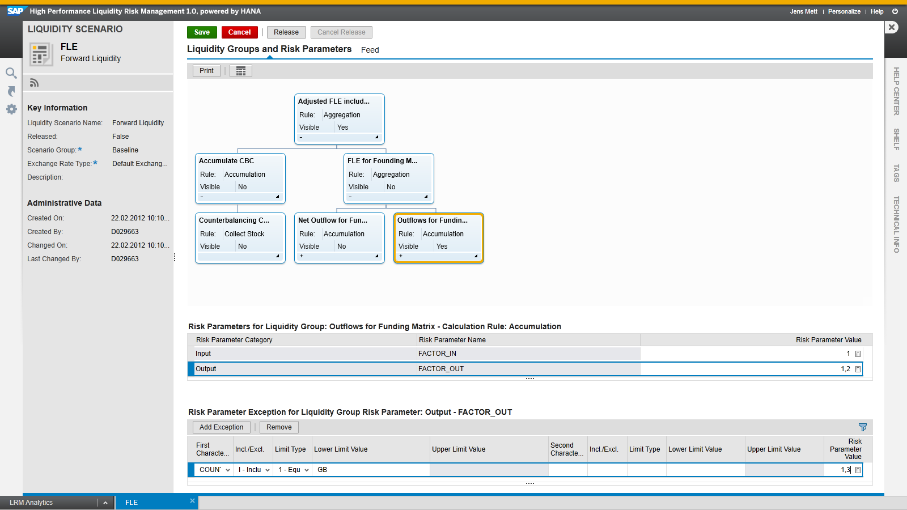
Liquidity Scenarios
Liquidity Risk Management wants to simulate future scenarios. Calculating such an outlook requires making assumptions on market data that influence cashflows, e.g.
Stock prices, FX rates, Interest curves
Haircuts
Counterparty data (ratings)
Behavioral assumptions (Run-off and renewal rates)
These risk parameters’ values are managed as ‘Liquidity Scenarios’

Slide 46
Liquidity Scenarios
In its first release, LRM@HANA focuses on reporting and high-speed aggregation and less on simulation.
Thus the support for scenarios is restricted to some essential dimensions:
LRM Scenario
FX rates
Liquidity Group Variables
Scenario IDs for cashflows per Origin ID
How to convert transactional into target currency?
How to adjust a certain cashflow (item)?
Example: Haircut
Which Cashflow Scenario to select from the DB?

Slide 47
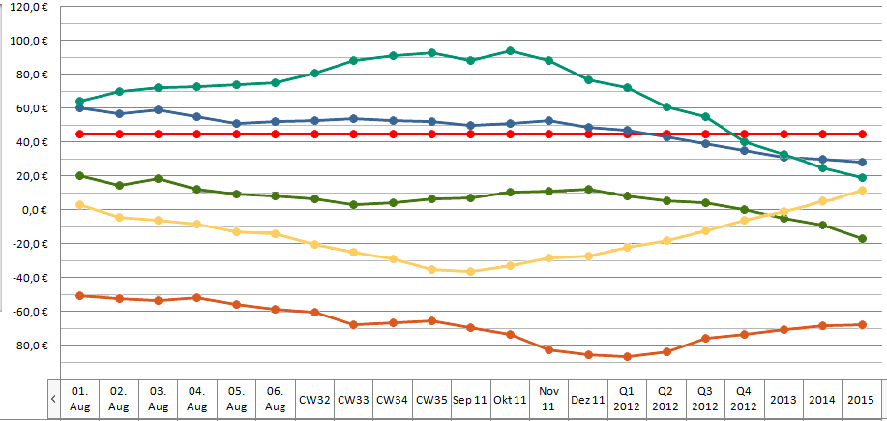
Calculation Engine Runtime
The calculation engine is called with a set of runtime parameters:
One or several pairs of Liquidity Groups and Scenarios
Key date
Maturity band
Target Currency
The calc engine’s results are provided by the requested groups’ output parameters and consumed by analytical UIs or persisted as files.
“Calculate Red Liqui Groups for Mat Band ‘A’ / Key Date ’01.08.2011’ / scenario ‘Basel III’ / target currency ‘EUR’”
Basel III LCR
High Quality Liquid Assets
Net Outflows
Level 1 HQLAs
Level 2 HQLAs
Outflows
Inflows
Cash
Central Bank Reserves
Domestic Sovereign 0%-risk Debt
Retail Deposits
Secured Funding
Unsecured Funding
Sovereign 20%-risk debt
AA- corporate binds
AA- covered bonds
Reverse Repos
Retail Counter-parties
Wholesale counter-parties

Slide 48
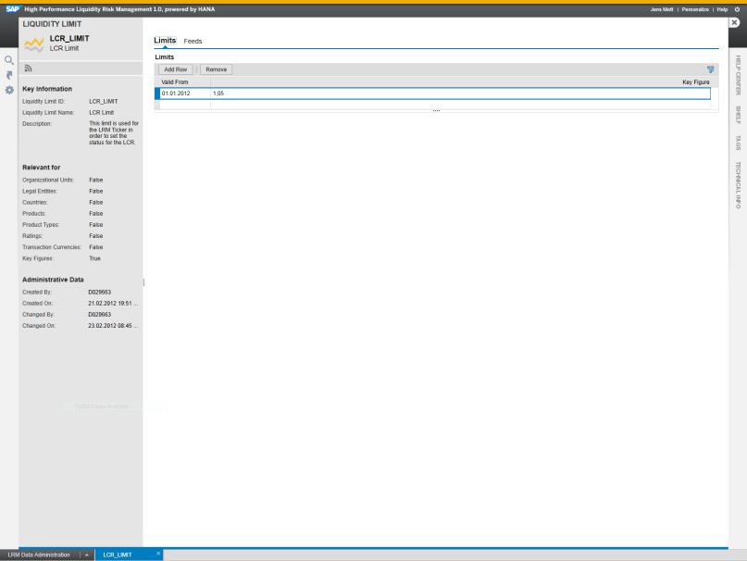
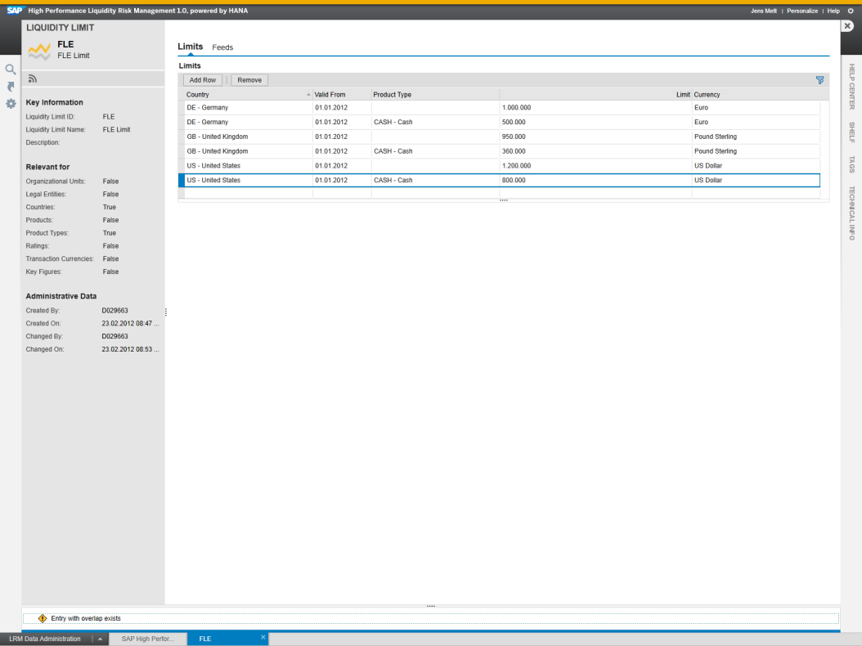
LRM Liquidity Limits
The LRM Liquidity Limit is used as a graphical indicator in charts as well as an indicator during the automatically monitoring of key figures and curves
Limits can be maintained time window-based for the following combinations of attributes (wild cards are possible):
Organizational Units
Legal entities
Products and product types
Ratings
Transaction currencies
Limits can be imported from central systems via an interface

Slide 49
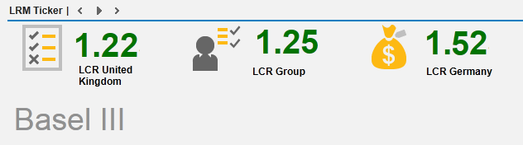

LRM Ticker
The LRM Ticker tool is able to evaluate and monitor the results of the calculation engine
Results are show on the Homescreen, the user’s starting point into the LRM application
Define limits for key figures and result curves
Combine calculation engine results with limits and define them as a new alert (e.g. LCR)
Define custom specific rules for the evaluation or use predefined LRM rules
Alerts are visualized in green or red according to evaluation result
Automatically actualization of alerts can be defined in a range between minutes up to hours
Support of drilldown into result charts

Slide 50
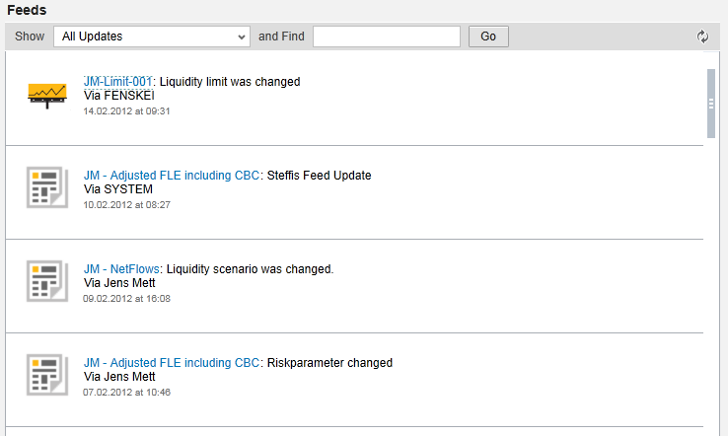
LRM Collaboration - Feeds
LRM Feeds inform about other users’ activities and changes to important objects
LRM supports manual and automatic feeds
Manual feeds are used to inform other users about changes or just for collaboration
Automatic feeds are generated automatically whenever objects in LRM are changed
LRM users must follow selected objects in order to be informed via feeds
Feeds are available for
Liquidity scenarios
Limits
Cash flows

Slide 51
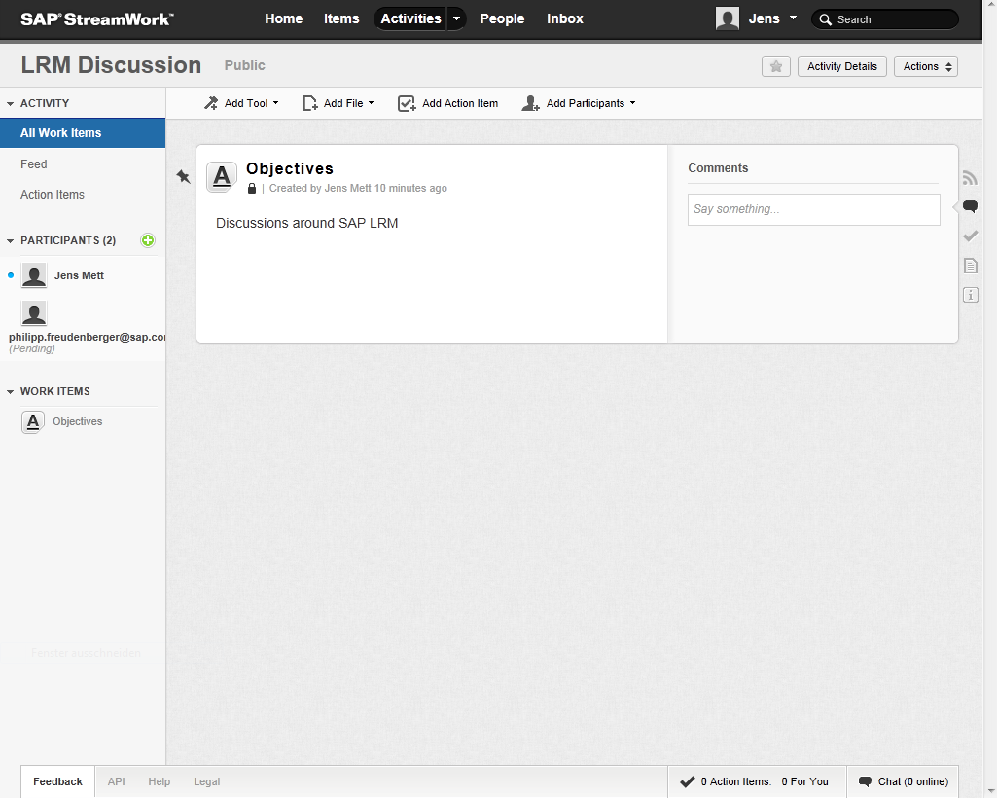
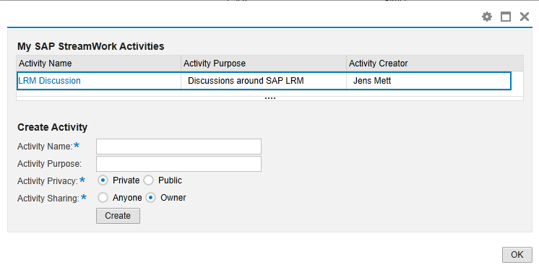
LRM Collaboration – SAP StreamWork
The SAP StreamWork Integration allows a collaborative decision-making
Brings together the people, information, and proven business approaches to drive fast, meaningful results
Get everyone on the same page
Share documents and data all in plain view
Provide structure with tools for brainstorming and decision-making
LRM allows you to
Create new SAP StreamWork activities
Post comments to existing SAP StreamWork activities

Slide 52
Backup

Slide 53
Liquidity risk processing in SAP LRM@HANA Rel. 2.0
Complete analytic use cases
Manipulate big data on the fly
Define simple adhoc scenarios quickly
High speed enables true playing experience
Leverage Predictive@HANA
Reporting & Analysis
Detailed Analysis
What-If Analysis
Legal Reporting
Aggregation
Cash flow aggregation
High volumes of simple cashflows quickly
Atomic granularity
Leave generation of complex cash flows to frontend/trading systems
Cash flow generation
Cash flow generation
Transaction

Slide 54
SAP LRM@HANA creating Value in your Risk Management
Perform real-time, high-speed liquidity risk management and reporting
Assess future liquidity developments on the fly by using scenarios
Comply with regulatory requirements introduced with Basel III
Gain competitive advantages in procuring liquidity by being faster and leaner
Collaborate efficiently and effectively among your organization
Access to the latest technology developments of SAP HANA
One step ahead with SAP Liquidity Risk@HANA. It provides answers to your questions... and more... It gets you the answers to questions you never even dared to ask!

Slide 55
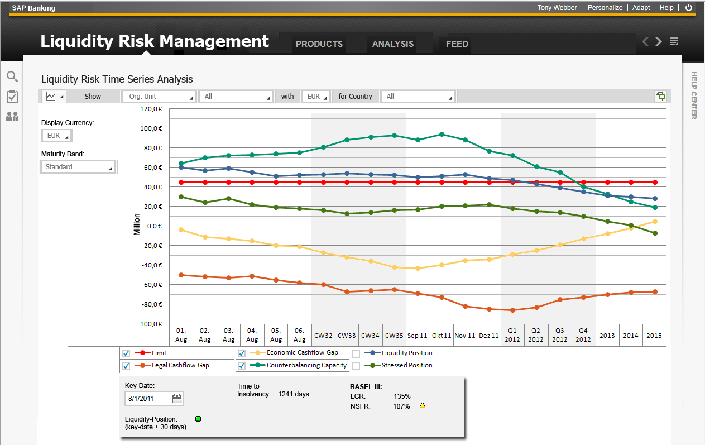
LRM Mockup: Funding Matrix

Slide 56
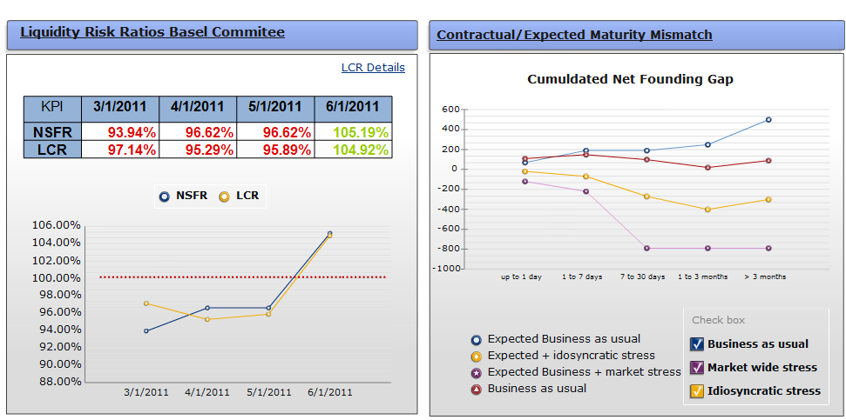
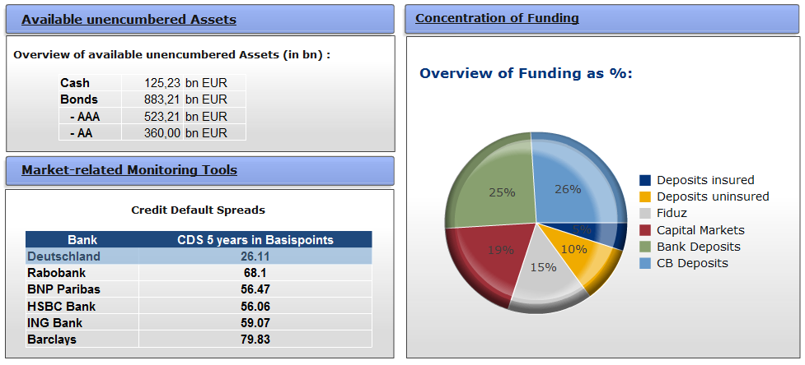
LRM Mockup: Key Figure Cockpit

Slide 57
Master Data Hierarchies
DRAFT
LRM@HANA keeps slim records of essential master data in hierarchical structures, enriched with essential characteristics:
Organizational Structure
Products
Business Partners
The cashflow object keeps anchors into these hierarchies.
Group
APJ
EMEA
France
Germany
LoB Retail
South
North
Branch 1
Branch n

Slide 58
Thank You!
Contact information:
Philipp Freudenberger
Product Management HANA Applications
philipp.freudenberger@sap.com
+49 170 2200403

